Slide 1
Rising criminalization & employment: early evidence
Ryan Larson, Sarah Shannon, Aaron Sojourner & Chris Uggen
Minneapolis Fed Opportunity & Inclusive Growth Institute
5/11/18

Slide 2
Overview
How has rise in Americans living in community with a felony record been associated with changes in non-employment rates?
Leverages new estimates of share of adults (18+) with a felony record living in the community for state-years in 1980 to 2010 [Shannon et al (2017) Demography]
Connects prime-age labor-market outcomes using state difference-in-difference models

Slide 3
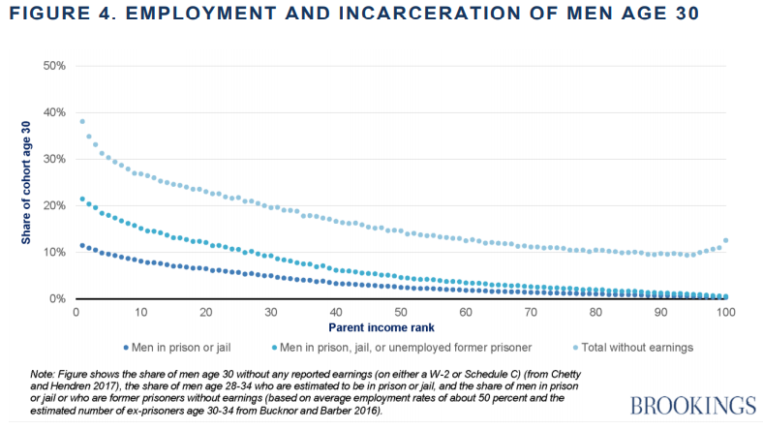
Looney & Turner (2018)

Slide 11
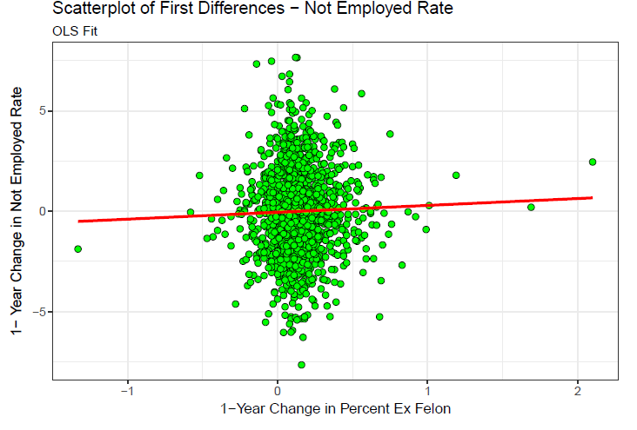

Slide 12
Rise in felony-history share (1 pp) associated with what pp change in prime-age (PA) not-employed?
0.53***: state FE & Year FE
0.34 : +population age shares
0.31 : +min wage, max TANF/UI benefit, disability share, married
0.34*** : +3 lags of state overall unemployment rate
0.29*** : +current overall unemployment rate
Significant at: * 5% **1% *** 0.1%

Slide 13
Alternative specifications
0.29*** on PA not-employed rate: baseline
0.27*** on PA idleness rate
0.10* on PA unemployment rate (omitting current overall UR)
0.08 on PA male not-employed
0.40*** on PA female not-employed
Significant at: * 5% **1% *** 0.1%

Slide 14
Future directions
Preliminary: more research needed
Strong labor market offers us a once-in-a-decade (generation?) chance to spread opportunity widely
New demand met with new supply keeps expansion going. Invest in active labor market policies.

Slide 15
CEA (2016) Issue Brief: Active Labor Market Policy

Slide 16
Future directions
Preliminary: more research needed
Strong labor market offers us a once-in-a-decade (generation?) chance to spread opportunity widely
New demand met with new supply keeps expansion going. Invest in active labor market policies.
Create community safety without criminalization
Do not stigmatize carelessly. Consider what kind of information is valuable & equitable to transmit to whom when.

